Slide 1

EMPATHY MAPPING
Empathize—Understand what is important to your employees

Slide 2
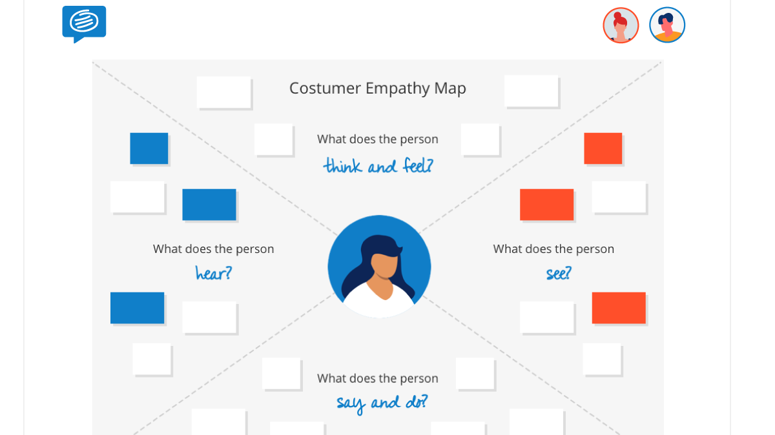
WHAT ARE PEOPLE THINKING AND FEELING?
Ask team members to capture:
Employee’s emotions and feelings.
What really matters to the employee, what are their major concerns as it relates to the subject?
WHAT ARE PEOPLE HEARING?
Ask team members to capture :
What is being said and shared about this subject?
How and from where are they hearing this information?
WHAT ARE THE PEOPLE SEEING?
Ask team members to capture :
What actions or behaviors are employees seeing as it relates to the subject?
What are they seeing happening in the external environment/ competitors?
Is what they are seeing, matching what they are hearing?
WHAT ARE PEOPLE SAYING AND DOING?
Ask team members to capture :
What are employees actually saying about the subject?
Has any action been taken about the subject
Is there a coherence between what is said and what is done.
Once complete, collate post-its with similar comments and summarize the key findings for the debrief.

Slide 3
5 WHY’s
Define—The root cause of the problem, this helps us ensure we address the problem not only the symptom

Slide 4
5 WHYS
1. Define the Problem
2. Ask the First Why
3. Ask why 4 more time
5. Know when to stop
Pick up the key findings from the empathy map
For Ex: Decisions are not getting communicated effectively.
Write the problem statement on the whiteboard/ flip chart, leaving enough space around it to add the answers to the repeated question, "Why?“
Ask your team WHY the problem is occurring.
(For example, "Why are decisions not getting communicated effectively.
Asking "Why?" sounds simple, but answering it requires serious thought. Search for answers that are grounded in fact: they must be accounts of things that have actually happened, not guesses of what might be happening. Your team members may come up with one obvious reason why, or several plausible ones. Record their answers as succinct phrases, rather than as single words or lengthy statements, and write them below (or beside) your problem statement. For example, saying “line managers do not explain rationale behind every decision " is better than a vague “managers are unclear”.
For each of the answers that you generated in Step 2, ask four further "whys" in succession.
Each time, frame the question in response to the answer you've just recorded.
You'll know that you've revealed the root cause of the problem when asking "why" produces no more useful responses, and you can go no further. If you identified more than one reason in Step 3, repeat this process for each of the different branches of your analysis until you reach a root cause for each one.

Slide 5
EXAMPLE:
PROBLEM STATEMENT: Decisions don’t get communicated effectively.
WHY?
Managers do not explain the rationale behind decisions and hence the communication suffers
WHY?
Managers do not find the time to sit with the teams to explain rationale and manage expectations around such decisions
WHY?
Managers are busy firefighting everyday issues and listening to employees tends to take a backseat
WHY?
Managers don’t have a specific time and communication channel to discuss issues like these
WHY?
No apparent reason- but can be fixed if managers can accommodate this on their weekly schedules

